Slide 1
An introduction to sentiment analysis and opinion mining
Shreshth Sudhir

Slide 2
INTRODUCTION
About Twitter
Social networking and microblogging services.
Enables users to send and read messages
Messages of length up to 280 characters, known as “tweets”.
DATA ANALYSIS of the thoughts and
opinions of the data on twitter dataset

Slide 3
RELATED WORK
Using Social media to predict to predict the future become very popular in recent years.
Prediction of Election with social media(Lei Wang and John Q Gan ,2017) uses twitter data to predict 2017 French Election.
Predicting the future with social media(Sitaram Asur and Bernardo A.Huberman,2010) tries to show that twitter based prediction of box office revenue performs better than market based prediction.

Slide 4
WORK
Data Collection: Existing Twitter data set and recent tweets via Twitter API.
Data Pre-processing: Get the “clean” data and transform it to the format we need.
Sentimental Analysis : Train a classifier to classify the tweets as : positive , negative or neutral.
Use the statistics of the tweets to analyse the sentiments of the people about any specific topic.

Slide 5
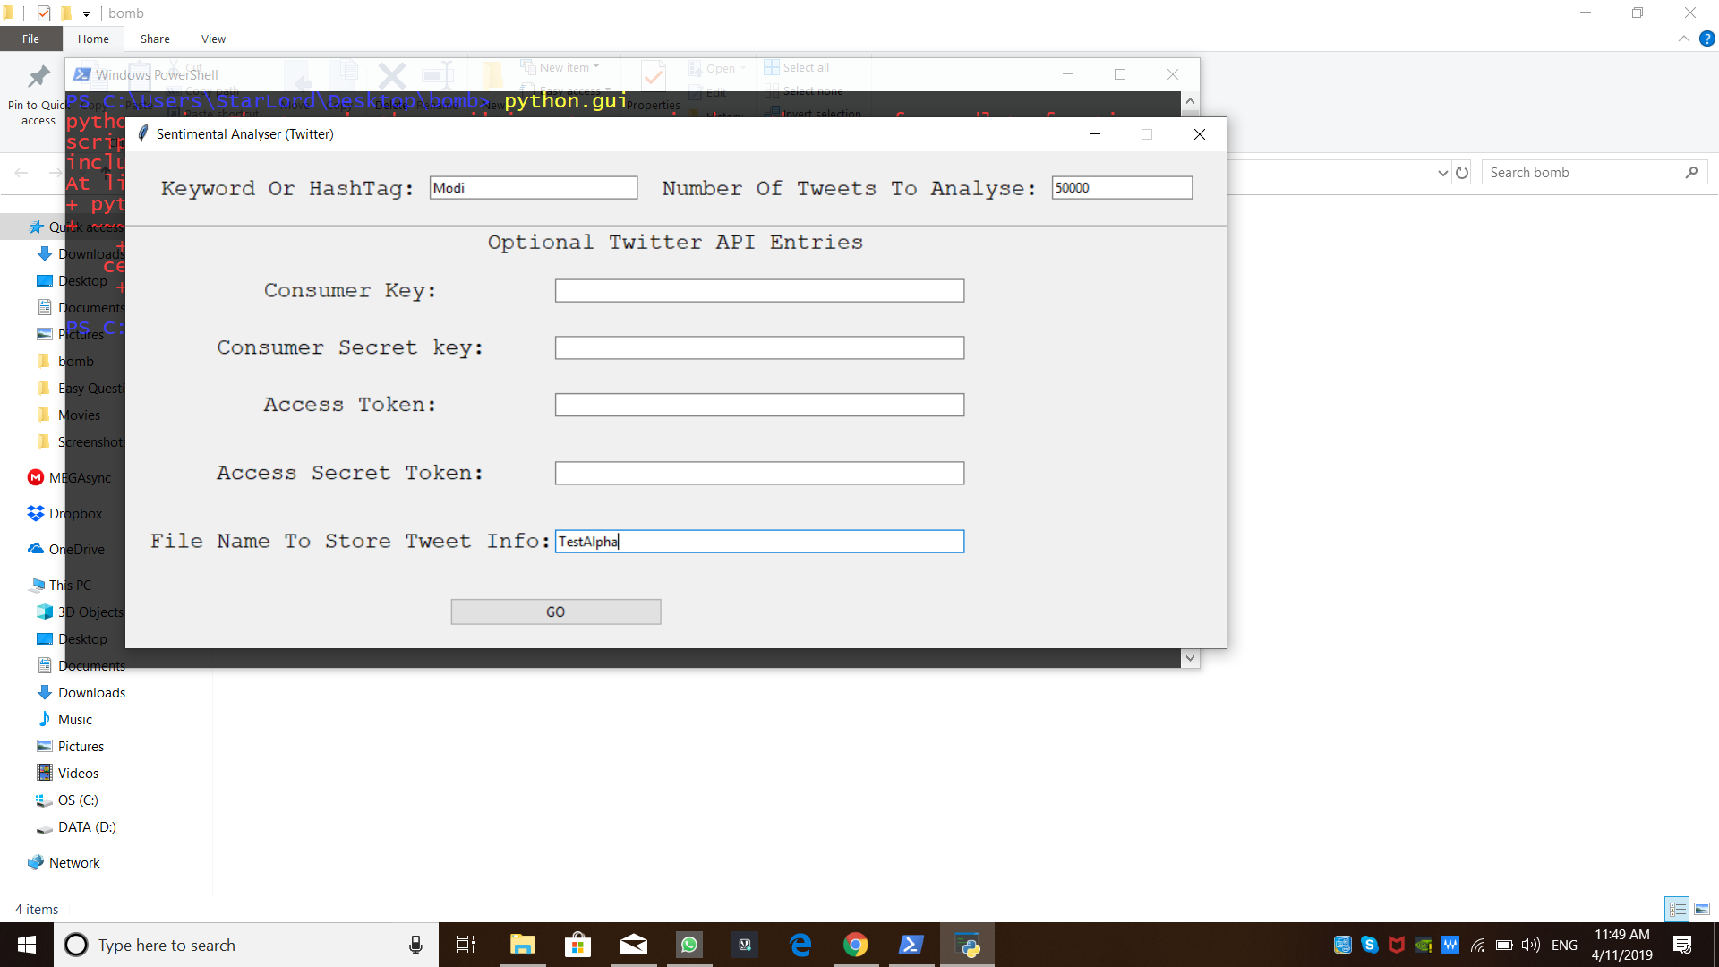
User Interface Based On tkinter

Slide 6
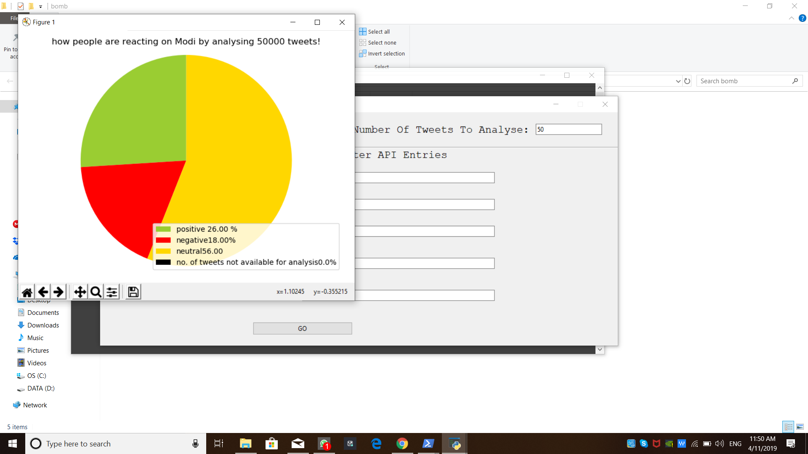
Output Using Matplotlib

Slide 7
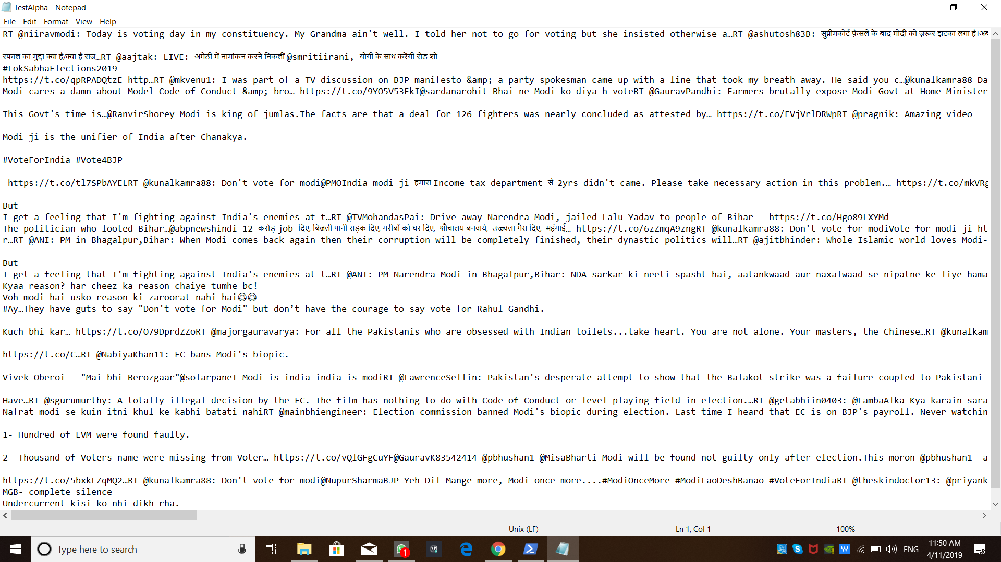
Text File Encoded IN utf-8-sig

Slide 8
Sentiment Analysis
Sentiment analysis is the detection of attitudes
“enduring, affectively colored beliefs, dispositions towards objects or persons”
Holder (source) of attitude
Target (aspect) of attitude
Type of attitude
From a set of types
Like, love, hate, value, desire, etc.
Or (more commonly) simple weighted polarity:
positive, negative, neutral, together with strength
Text containing the attitude
Sentence or entire document

Slide 9
Sentiment Analysis
Simplest task:
Is the attitude of this text positive or negative?
More complex:
Rank the attitude of this text from 1 to 5
Advanced:
Detect the target, source, or complex attitude types

Slide 10
Goals and non-goals
Goals
Understand the basic ideas of sentiment analysis
Understand how computer-scientist text miners approach “sentiment“ and “opinion“
Time permitting: Learn how different disciplines view these two concepts
Learn about some pitfalls and encourage a critical view
Get your hands on some tools and real data
Since this field is more involved than basic text mining, we will remain at a high level
Have pointers for inquiring and going further
Non-goals (selection)
the statistical background of methods
A comprehensive overview of the state-of-the-art of sentiment analysis methods
(See the surveys in the references for this)
A comprehensive overview of the state-of-the-art of sentiment analysis applications in the digital humanities or social or behavioural sciences

Slide 11
METHODOLOGIES
Data Pre-processing
Why data pre-processing ?
Lot of noisy, spam, irrelevant tweets in our dataset.
Convert the data to input format for our sentiment analysis tools.

Slide 12
METHODOLOGIES
How does this sentimental analysis work?
Step-1: Tokenization
The movie was Great!
Tokenization
*The
*movie
*was
*Great
*!

Slide 13
METHODOLOGIES
Step-2: Cleaning the data
The movie was Great!
Remove the special
characters.
* The
* movie
* was
* great
* !

Slide 14
METHODOLOGIES
Step-3: Removing stop words
The movie was Great!
Remove the stop
words
* The
* movie
* was
* great
* !

Slide 15
METHODOLOGIES
Step-4: Supervised algorithm for classification
Positive:+1
Negative:-1
The movie was Great! Neutral:0
* The
* movie 0
* was
* great +1
* !

Slide 16
METHODOLOGIES
Step-5: Calculation:
The movie was Great!
0+1=1 (Since the polarity>0 so given
statement is positive)
* The
* movie 0
* was
* great +1
* !

Slide 17
A field of study with many names
Opinion mining
Sentiment analysis
Sentiment mining
Subjectivity detection
...
Often used synonymously
Some shadings in meaning
“sentiment analysis“ describes the current mainstream task best 🡺 I‘ll use this term.

Slide 18
Aspect-oriented sentiment analysis: It‘s not ALL good or bad
Yesterday, I bought a Nokia phone and my girlfriend bought a moto phone. We called each other when we got home. The voice on my phone was not clear. The camera was good. My girlfriend said the sound of her phone was clear. I wanted a phone with good voice quality. So I was satisfied and returned the phone to BestBuy yesterday.
Small phone – small battery life.

Slide 19
The unit of analysis
community
another person
user / author
document
sentence or clause
aspect (e.g. product feature)
“What makes people happy“ example
Phone example
Notes:
TODO: hiervon werden einige besprochen, andere nicht -> markieren oder später drauf zurückkommen

Slide 20
The analysis method
Machine learning
Supervised
Unsupervised
Lexicon-based
Dictionary
Flat
With semantics
Corpus
Discourse analysis
“What makes people happy“ example
“What makes people happy“ example
Phone example
Phone example

Slide 21
Features
Features:
words (bag-of-words)
n-grams
parts-of-speech (e.g. Adjectives and adjective-adverb combinations)
opinion words (lexicon-based: dictionary or corpus)
valence intensifiers and shifters (for negation); modal verbs; ...
syntactic dependency
Feature selection based on
frequency
information gain
odds ratio (for binary-class models)
mutual information
Feature weighting
term presence or term frequency
inverse document frequency (🡪 TF.IDF)
term position : e.g. title, first and last sentence(s)

Slide 22
Objects, aspects, opinions (1)
Yesterday, I bought a Nokia phone and my friend bought a moto phone. We called each other when we got home. The voice on my phone was not clear. The camera was good. My friend said the sound of his phone was clear. I wanted a phone with good voice quality. So I was satisfied and returned the phone to BestBuy yesterday.
Small phone – small battery life.
Object identification

Slide 23
Objects, aspects, opinions (2)
Yesterday, I bought a Nokia phone and my friend bought a moto phone. We called each other when we got home. The voice on my phone was not clear. The camera was good. My friend said the sound of his phone was clear. I wanted a phone with good voice quality. So I was satisfied and returned the phone to BestBuy yesterday.
Small phone – small battery life.
Object identification
Aspect extraction

Slide 24
Find only the aspects belonging to the high-level object
Basic idea: Tokenization
find frequent nouns / noun phrases
find the opinion words associated with them (from a dictionary: e.g. for positive : good, clear, amazing)
Find infrequent nouns co-occurring with these opinion words
BUT: may find opinions on aspects of other things
Improvements on the basic method exist
Notes:
Popescu, A. and O. Etzioni. Extracting product features and opin-
ions from reviews. In Proceedings of Conference on Empirical Meth-
ods in Natural Language Processing (EMNLP-2005), 2005.

Slide 25
Objects, aspects, opinions (3)
Yesterday, I bought a Nokia phone and my friend bought a moto phone. We called each other when we got home. The voice on my phone was not clear. The camera was good. My friend said the sound of her phone was clear. I wanted a phone with good voice quality. So I was satisfied and returned the phone to BestBuy yesterday.
Small phone – small battery life.
Object identification
Aspect extraction
Grouping synonyms

Slide 26
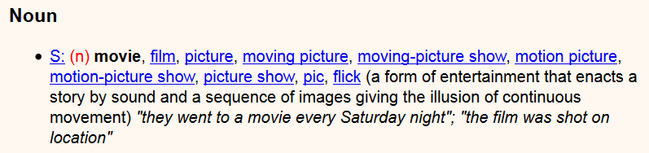
Grouping synonyms
General-purpose lexical resources provide synonym links
E.g. Wordnet
Notes:
Carenini, G., R. Ng, and E. Zwart. Extracting knowledge from eval-
uative text. In Proceedings of Third Intl. Conf. on Knowledge Cap-
ture (K-CAP-05), 2005.

Slide 27
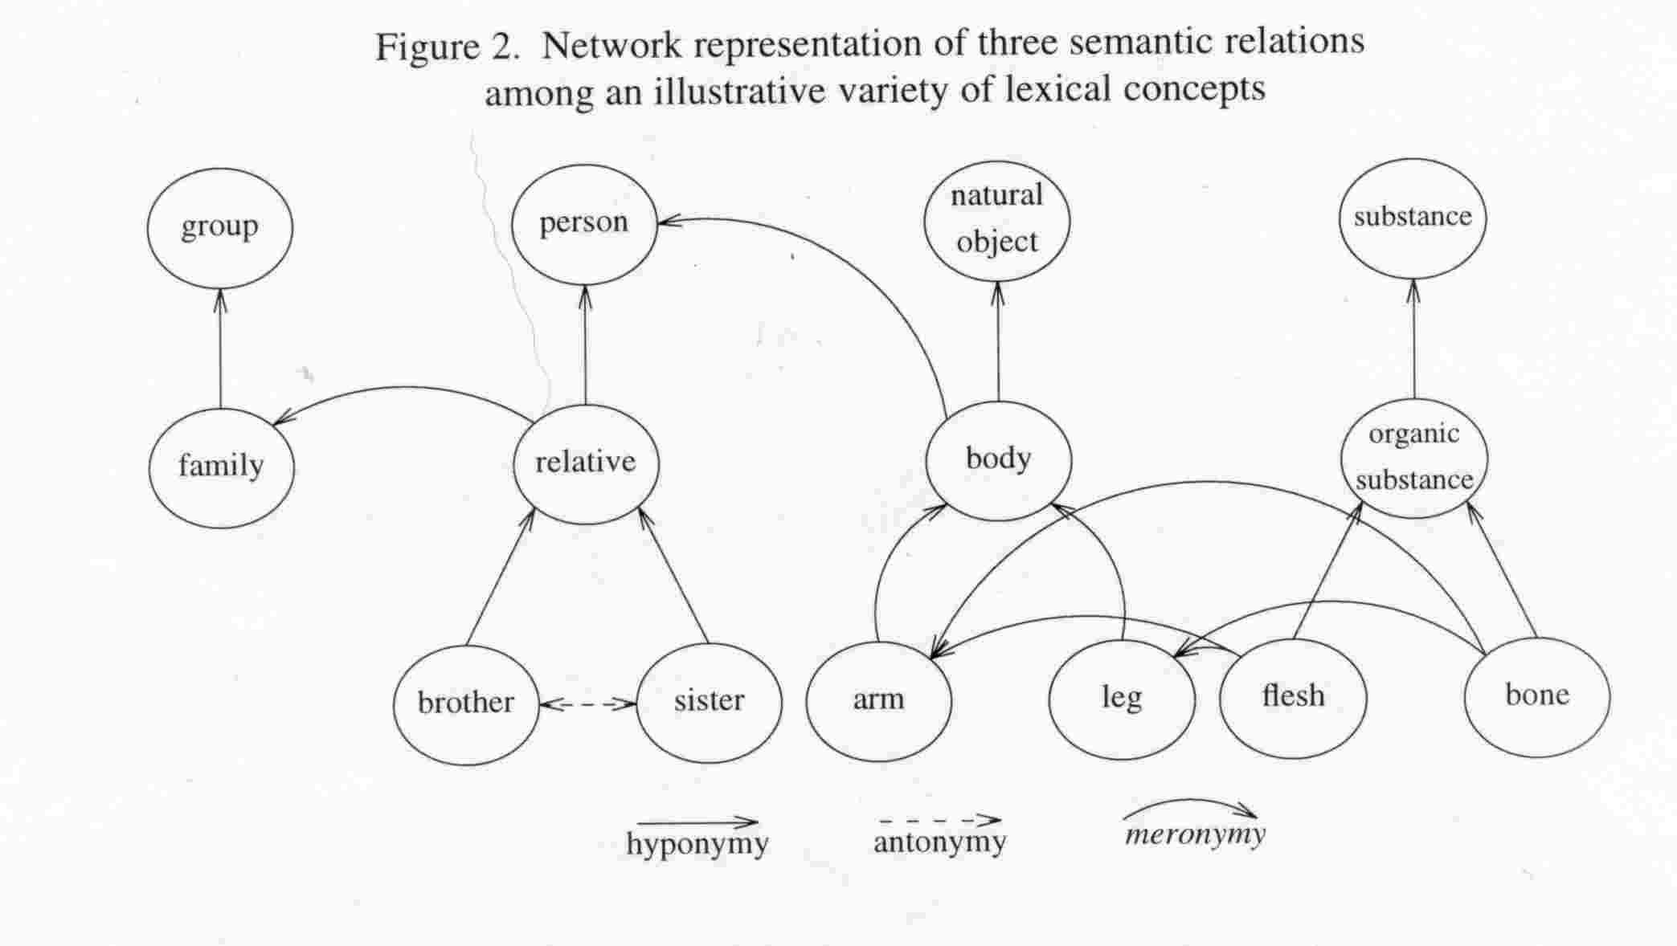
WordNet
Notes:
http://www-rohan.sdsu.edu/~ling354/nounnet.jpg

Slide 28
Objects, aspects, opinions (4a)
Yesterday, I bought a Nokia phone and my friend bought a moto phone. We called each other when we got home. The voice on my phone was not clear. The camera was good. My friend said the sound of his phone was clear. I wanted a phone with good voice quality. So I was satisfied and returned the phone to BestBuy yesterday.
Small phone – small battery life.
Object identification
Aspect extraction
Grouping synonyms
Opinion orientation classification

Slide 29
Objects, aspects, opinions (4b)
Yesterday, I bought a Nokia phone and my friend bought a moto phone. We called each other when we got home. The voice on my phone was not clear. The camera was good. My friend said the sound of his phone was clear. I wanted a phone with good voice quality. So I was satisfied and returned the phone to BestBuy yesterday.
Small phone – small battery life.
Object identification
Aspect extraction
Grouping synonyms
Opinion orientation classification

Slide 30
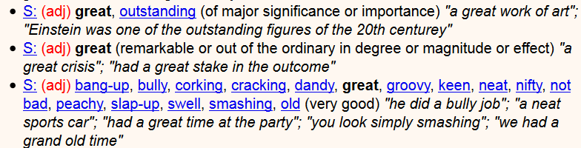
Opinion orientation
Start from lexicon
E.g. dictionary SentiWordNet
Assign +1/-1 to opinion words, change according to valence shifters (e.g. negation: not etc.)
But clauses (“the pictures are good, but the battery life ...“)
Dictionary-based: Use semantic relations (e.g. synonyms, antonyms)
Notes:
Researchers have also used additional information (e.g.,
glosses) in WordNet and additional techniques (e.g., machine learning)
to generate better lists [1, 19, 20, 45]. Several opinion word lists have
been produced [17, 21, 31, 90, 104].
21 = SentiWordNet

Slide 31
Objects, aspects, opinions (5)
Yesterday, I bought a Nokia phone and my friend bought a moto phone. We called each other when we got home. The voice on my phone was not clear. The camera was good. My friend said the sound of her phone was clear. I wanted a phone with good voice quality. So I was satisfied and returned the phone to BestBuy yesterday.
Small phone – small battery life.
Object identification
Aspect extraction
Grouping synonyms
Opinion orientation classification
Integration / coreference resolution

Slide 32
Not all sentences/clauses carry sentiment
Yesterday, I bought a Nokia phone and my friend bought a moto phone. We called each other when we got home. The voice on my phone was not clear. The camera was good. My friend said the sound of his phone was clear. I wanted a phone with good voice quality. So I was satisfied and returned the phone to BestBuy yesterday.
Small phone – small battery life.
Neutral sentiment

Slide 33
Subjectivity detection
2-stage process:
Classify as subjective or not
Determine polarity
A problem similar to genre analysis
e.g. Naive Bayes classifier on Wall Street Journal texts: News and Business vs. Letters to the Editor
Notes:
J. M. Wiebe, T. Wilson, R. Bruce, M. Bell, and M. Martin, “Learning subjective
language,” Computational Linguistics, vol. 30, pp. 277–308, September
2004.
307: J. Wiebe and R. Mihalcea, “Word sense and subjectivity,” in Proceedings of
the Conference on Computational Linguistics / Association for Computational
Linguistics (COLING/ACL), 2006.
---
[326] H. Yu and V. Hatzivassiloglou, “Towards answering opinion questions: Separating
facts from opinions and identifying the polarity of opinion sentences,”
in Proceedings of the Conference on Empirical Methods in Natural Language
Processing (EMNLP), 2003.

Slide 34
Special challenges in Tweets
Very popular data source
Mostly public messages
API
But: opaque sampling (“the best 1%“)
Vocabulary, grammar, ...
Length restriction
Semantic enrichment
Hyperlinked context
Thread context
Social-network context
Notes:
TODO ??? Is semantic enrichment done for opinion mining?

Slide 35
Conclusion
We presented a comprehensive set of experiments for two levels of classification: message level and phrase level on manually annotated data that is a random sample of the stream of tweets. For our feature-based approach, we do feature analysis which reveals that the most important features are those that combine the prior polarity of words and their part-of-speech tags

Slide 36
Future Work
We can start working on multiple languages like Hindi, Urdu, Spanish to provide sentiment analysis on the local basis.
We also plan on increasing the classification categories, so that we get better results.
Improving our system that can deal with sentences of multiple meaning.

